Slide 1
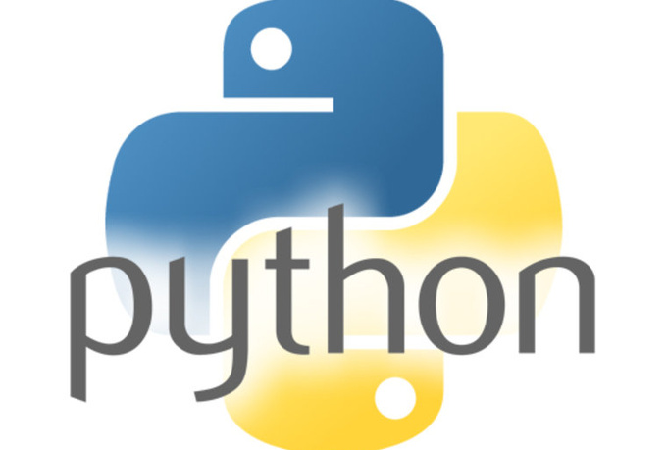
Slithering Into Python

Slide 2
What is Python?
A really cool programming language that is used in a lot of places
Easy to learn- very much like English

Slide 3
What are we going to do with Python?
Make some cool projects!
Learn basic coding and how to use some of the programming tools that are used on a daily basis
Have fun!

Slide 4
So what are we going to learn first?
Sublime text, a free text editor that is popular to use with Python
The terminal- some basic commands that will get you started with learning how to compile and run your code – a very useful skill
Some Ubuntu, which is what your computers are running on right now

Slide 5

Sublime Text

Slide 6
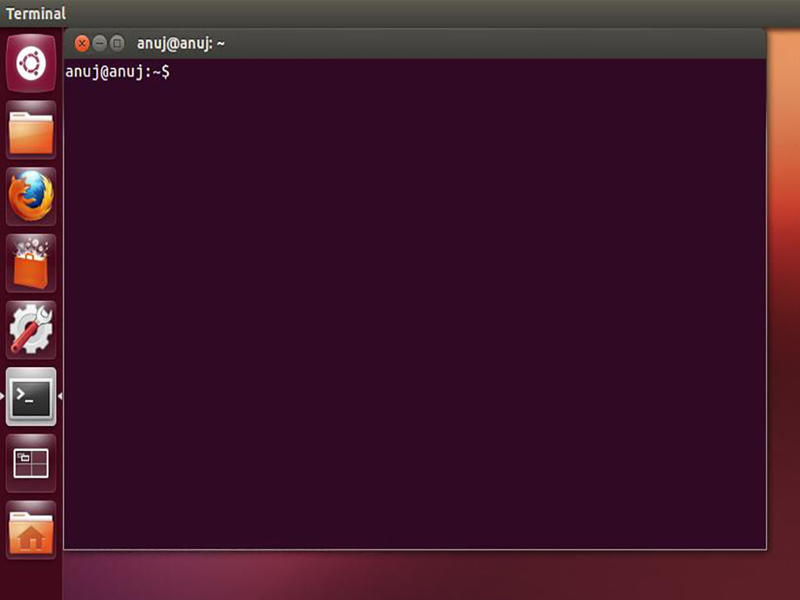
Terminal

Slide 7
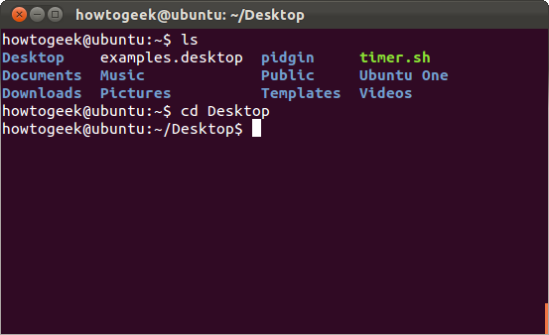
Some Terminal Commands
Change Drive- cd
  Allows you to change what directory you are in
  Ex: cd Desktop will bring you from home to your desktop

Slide 8
Some Terminal Commands
Print working directory- pwd
  Prints the name of the current directory you’re in- helpful in case you forget!

Slide 9
Now Onto Python….
Printing

Slide 10
For Some Practice
Open sublime and type print “Hello, World!”
Save file (ctrl + s)
Name file as hello_world.py and save it to your desktop
Go to your terminal and cd into Desktop
Type “python hello_world.py”
Your terminal should display “Hello, World!”

Slide 11
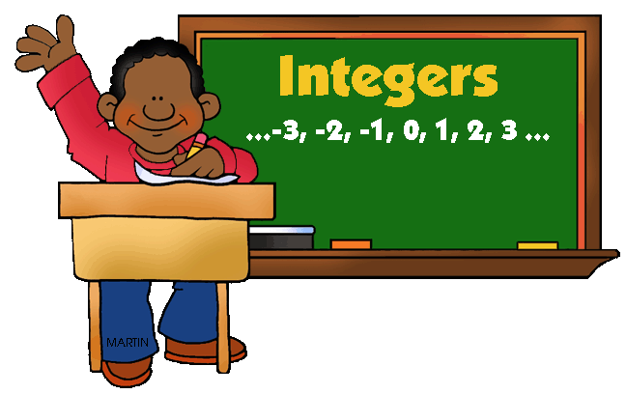
Data Types
Integer
Represented as int, but Python doesn’t require you to say int x = 2
Instead, just
X = 2

Slide 12

Data Types
String
Represented as a sequence of characters and can be changed, whereas an integer can’t
“Hello, World!” is an example of a string

Slide 13
Other Things You Need to Know
Loops
  Instructions that are repeated until a certain condition is met
  Ex: while(x < 2):
    Print “Hello, World!”
What is wrong with this loop?
  X is not defined, so we have to define it.
  Ex: x = 1
  If we run x = 1 with the above loop, what will happen?

Slide 14
Other Things You Need to Know
Random function
Generates random numbers
Import random

Slide 15
Dice Rolling Simulator
Simulate a rolling dice
Needed:
Random function (import random)
A minimum number (possibly 1 for the lowest count side of a dice)
A maximum number (possible 6 for the highest count side of a dice)
Print statements telling when the dice is rolling and what the values are
The function random.randint(max, min)
An option to roll the dice again

Slide 16
More Things You Need to Know
If statements
Like in English: if I do this project, then I’ll learn Python
If x = 2:
Print “Hello, World!”

Slide 17
More Things You Need to Know
Variables
X = 2, where x is a variable
Data type that holds a value
Can be used in multiple places, to print a variable such as
MyName = “Morgan”
Print “Hello, MyName”
Prints Hello, Morgan

Slide 18
More Things You Need to Know
Input
Takes input from user
Typically represented as raw_input

Slide 19
Guess the Number
Create a number guessing game
Needed:
Random function
  This time you’ll need to use random.randint to make it have a random integer
  Ex: random.rantint(1, 20) to guess a number between 1 and 20
Print statements
If statements
Variables
Input
  Ex: The program asks for a number and you input 2

Slide 20
More Stuff to Know
Concatenation
The art of putting strings together, from end to end
Ex: “snow” “ball” concatenates to “snowball”

Slide 21
Break!
https://www.youtube.com/watch?v=r0qWVKcJR3w
https://www.youtube.com/watch?v=HYulyhYkH5s

Slide 22
Mad Libs Generator
Needed:
Strings
Variables
Concatenation
Print
Input

Slide 23
Adventure Game
Instead of building this, you’re going to play with it
You are in a cave and looking for an adventure

Slide 24
Hangman
Instead of building this one you will play with it

